Slide 1

Exploratory Data Analysis
G2M Cab Investment Case Study
25th June 2021

Slide 2
Agenda
Executive Summary
Problem Statement
Approach
EDA
EDA Summary
Recommendations

Slide 3
Executive Summary
XYZ is a private firm in the US, looking to invest in a key player in the Cab Industry, due to remarkable growth, as part of their Go-to-Market (G2M) strategy.
Objective of Report: Based on data from 2 major players in the industry, we must provide XYZ recommendations and actionable insights, backed by the data, to find the right company to make the investment.

Slide 4
Data Sets
The following datasets were used:
Cab_Data.csv – Transactions for Pink and Yellow companies (359392 Rows, 7 Columns)
Customer_ID.csv – Customer’s demographic details (49171 Rows, 4 Columns)
Transaction_ID.csv – Mapping from transactions to customers (440098 Rows, 3 Columns)
City.csv – Details of Cab Users in different cities in the US (20 Rows, 3 Columns)
USHolidays.csv – Dates and Name of US Federal Holidays between 2016-2018 (11 Rows, 4 Columns)
Time Period of Data: 01/01/2016 to 31/12/2018
Master Dataset: 20 Features and 359392 Records

Slide 5
Exploratory Data Analysis (EDA)
Approach
From the 5 datasets, we built a master data set.
We calculated the profit at the ‘per ride’ level, where profit = price – cost.
Next, we mapped the cities and and populations to each record.
Similarly, the customer’s data was mapped based on the transaction ID.
For the purpose of this evaluation, only the transactions that were done by the Pink or Yellow companies were considered.
The ‘Date of Travel’ field was split into Date, Month and Year in order to better explore the relationships hidden in the data.

Slide 6
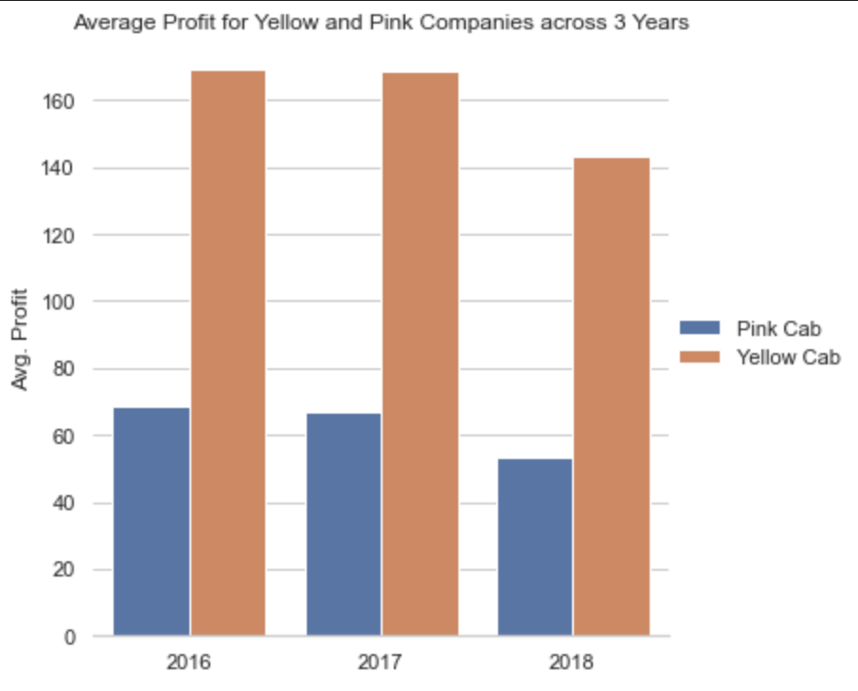
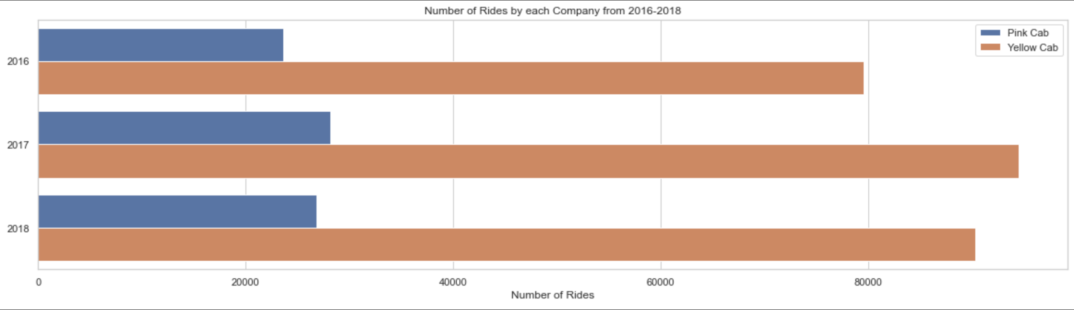
Analysis by Year (2016, 2017 & 2018)
When we look at the plots on the right, we see that the Average Yearly Profit earned by the Yellow Company is more than double than that of the Pink Company.
A possible reason for this could be the lack of resources to do more rides. We can see that the Yellow Company is doing more than double the Pink Company’s rides as well.

Slide 7
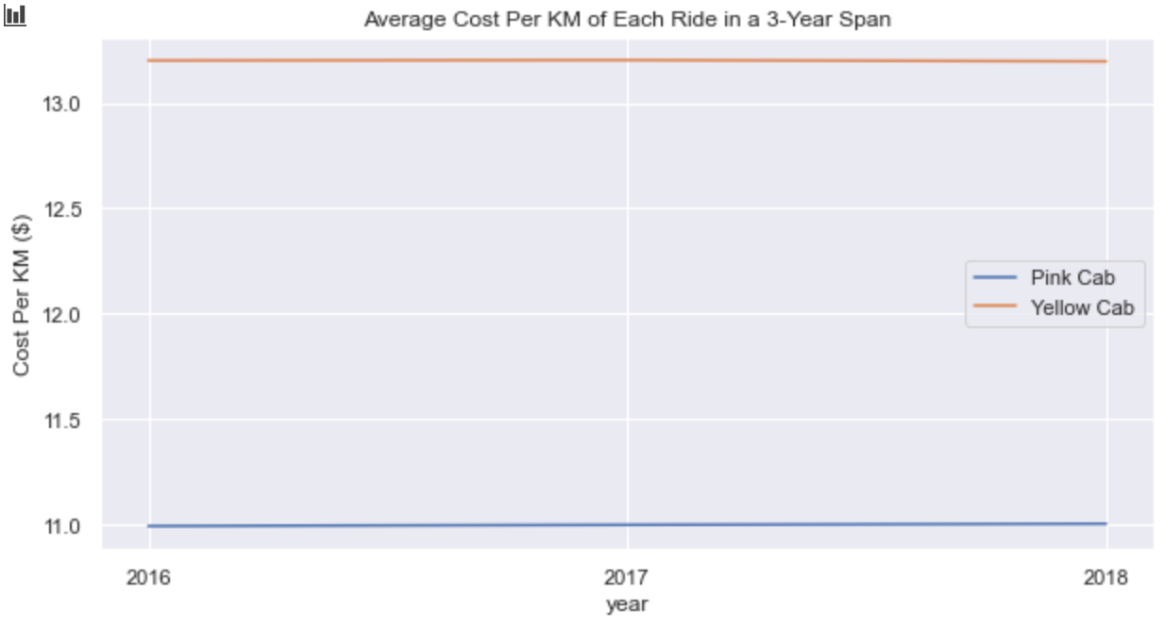
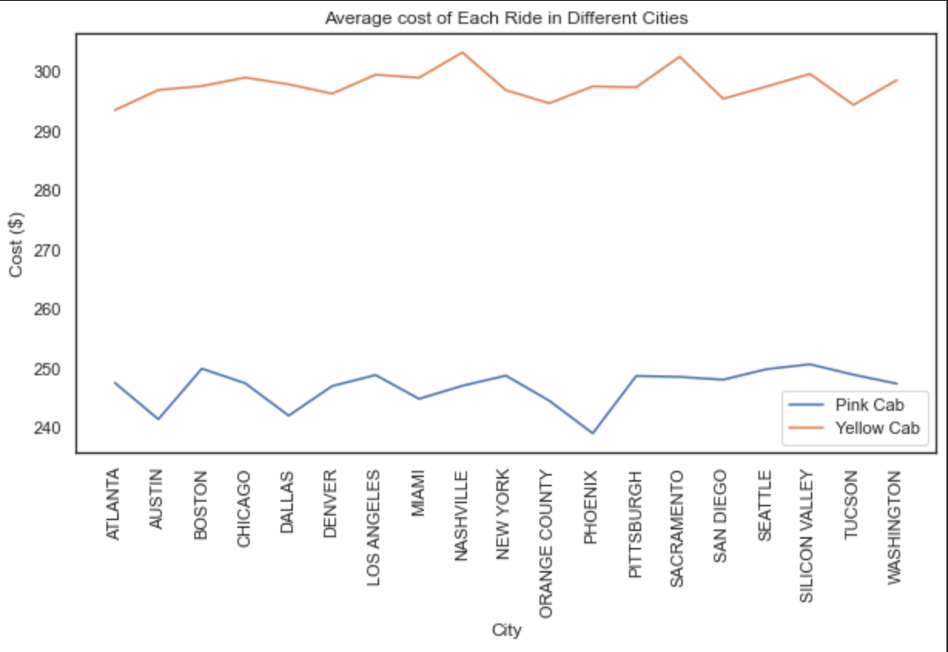
Cost Analysis (by City)
As we can see, over the span of 3 years (i.e. 2016-2018), the average cost per km of distance travelled hasn’t changed too much for either company. However, the difference between this cost is almost $2. This could be because of higher quality service offered by the Yellow Company.
The a

Slide 8
Thank You

